Slide 1
Text Types
Creative Written Task

Slide 2

Text types follow conventions.
convention (n):
a way in which something is usually done
custom
protocol
Each text type has a set of conventions that it must adhere to.
F O R E X A M P L E
A few conventions:
casual register to capture a personal point of view
pictures, videos, and links
comment box
presented in reverse chrono-logical order
a blog post

Slide 3
What is a blog post?
blog post (n):
a written entry or article that is accompanied by photos, infographics, videos, and/or links, and is presented in a blog
What is a blog?
blog (n):
an interactive information website that provides commentary on a particular subject in the form of journal-like entries

Slide 4

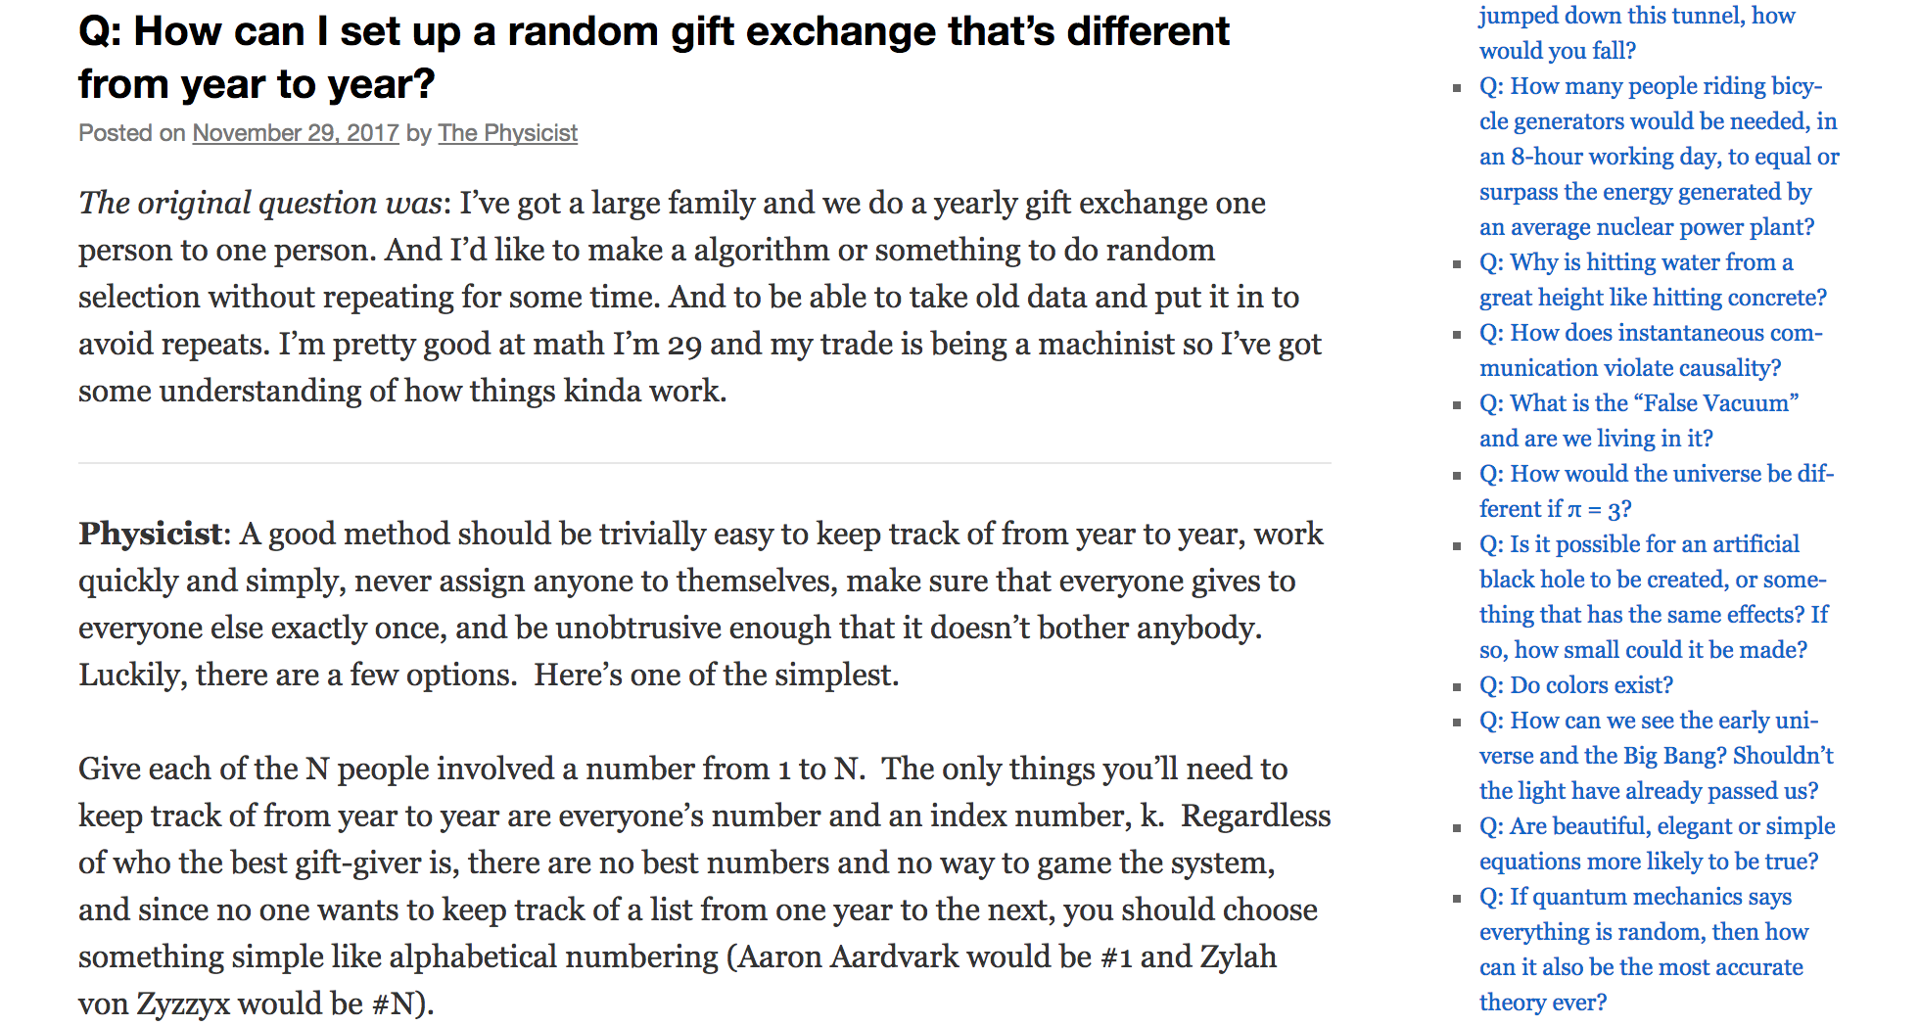
blog title
blog post title + date of publication
links to other posts in this blog
casual register

Slide 5
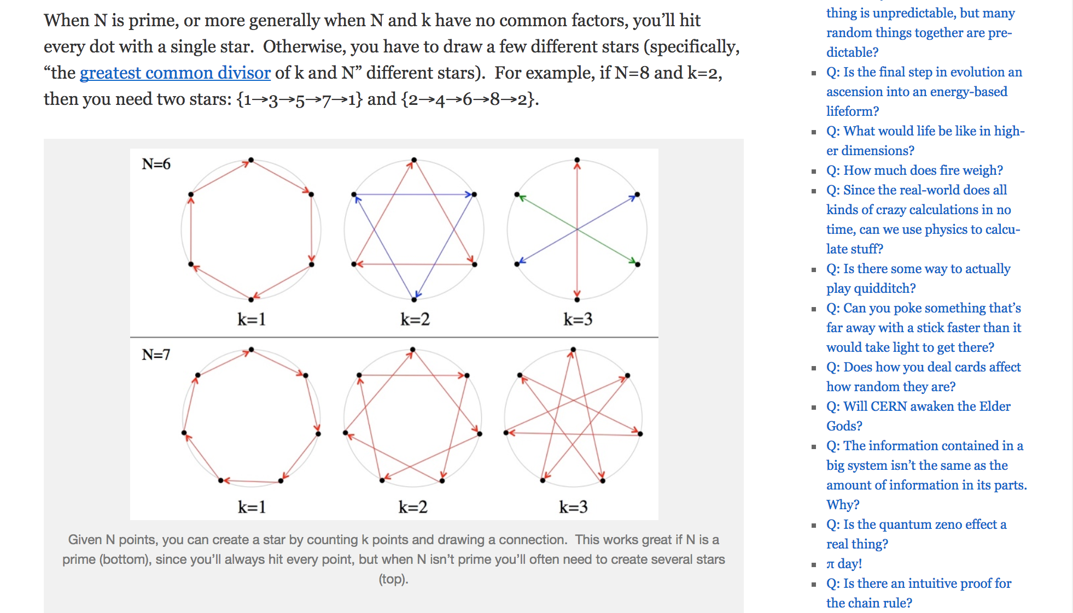
a link to information that is located elsewhere on the Internet
visual image
function buttons & social plugins

Slide 6
What is a charity appeal?
charity appeal (n):
a written request that asks the public for money, volunteer service, or another form of assistance that can help a charitable organization achieve its goals

Slide 7
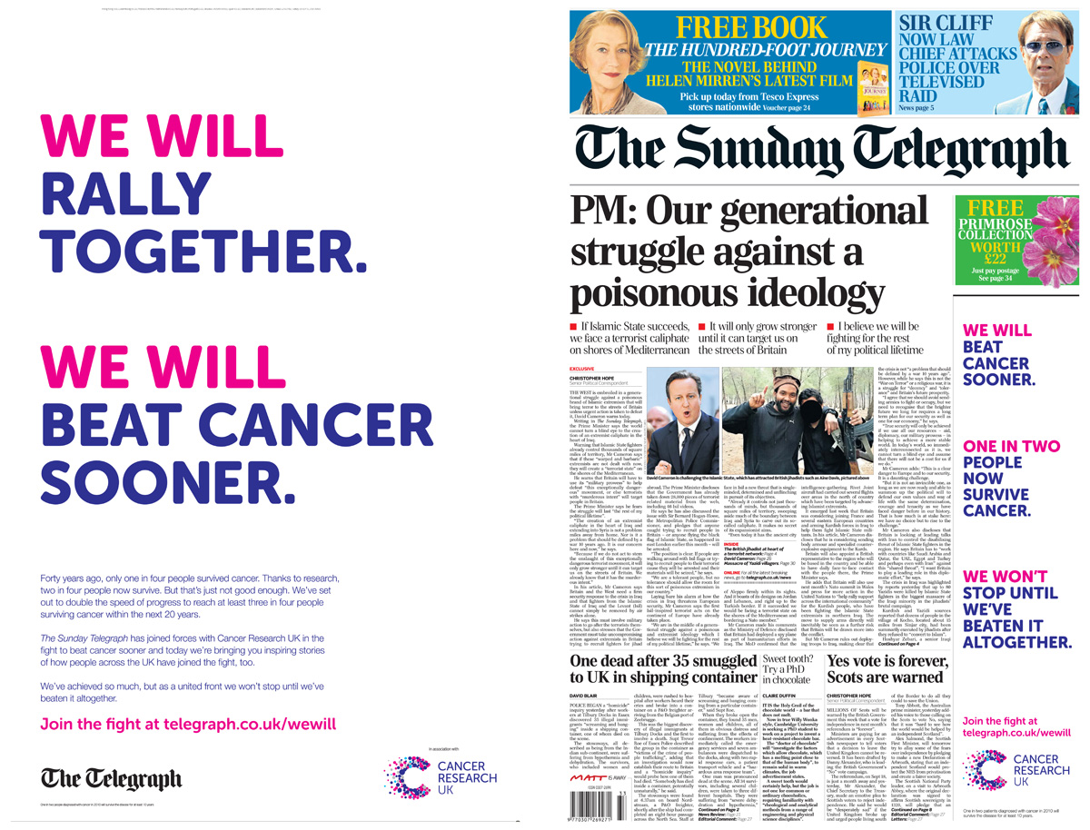
sense of inclusion
use of statistics / appeal to logos
sense of hope and determination
charity’s
signature
contact information
support from respected source

Slide 8
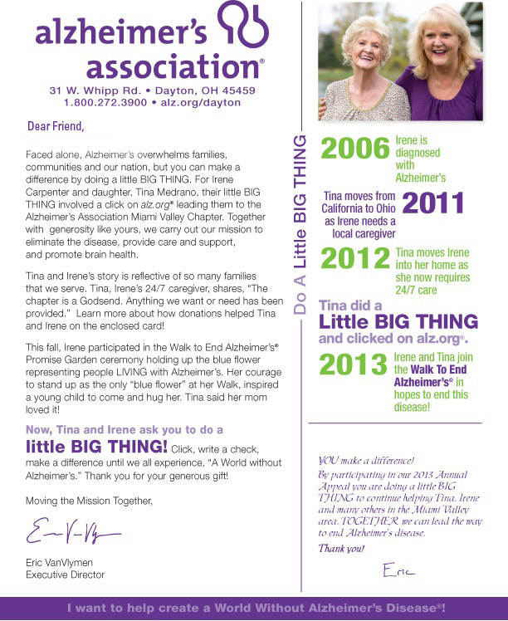
links to real life
appeal to pathos
proof of impact
imperative statements
sense of gratitude
declarative statements

Slide 9
What is an incident report?
incident report (n):
a written account that records the key details of a noteworthy or unusual event, typically comprised of what victims and witnesses have observed and the reporter’s notes concerning the investigation and analysis of the event

Slide 10
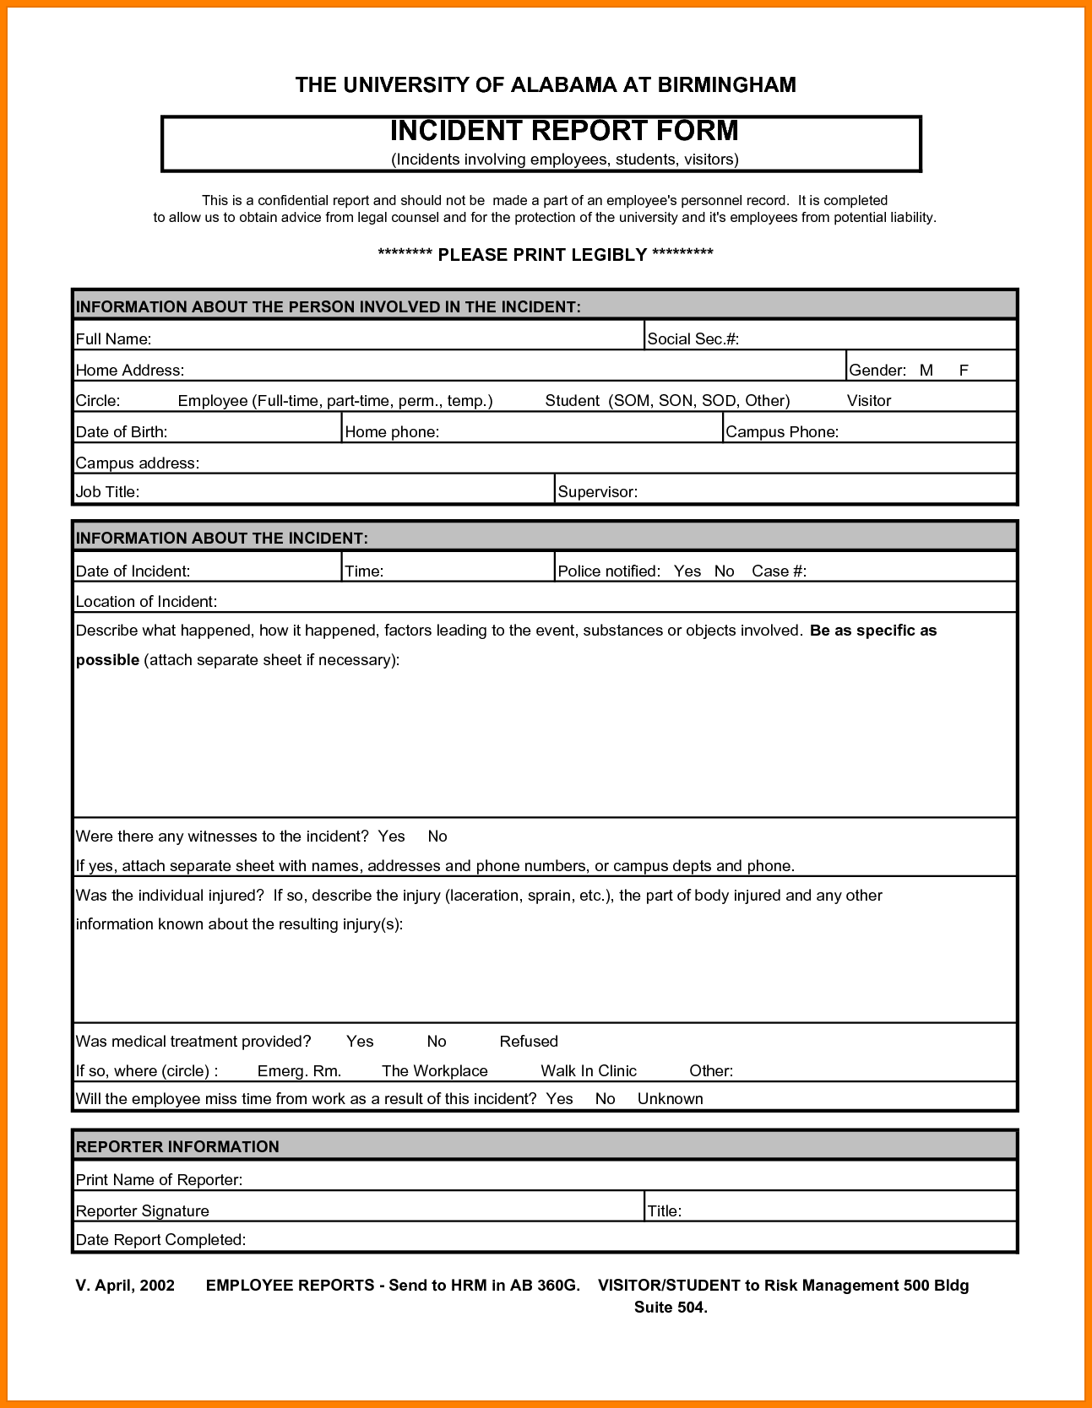
name of the institution collecting the information
name of the form
instructions
clearly labeled sections
designated boxes in which specific information is entered
request for the “5 Ws”

Slide 11
request for the “5 Ws”
reporter’s contact information

Slide 12
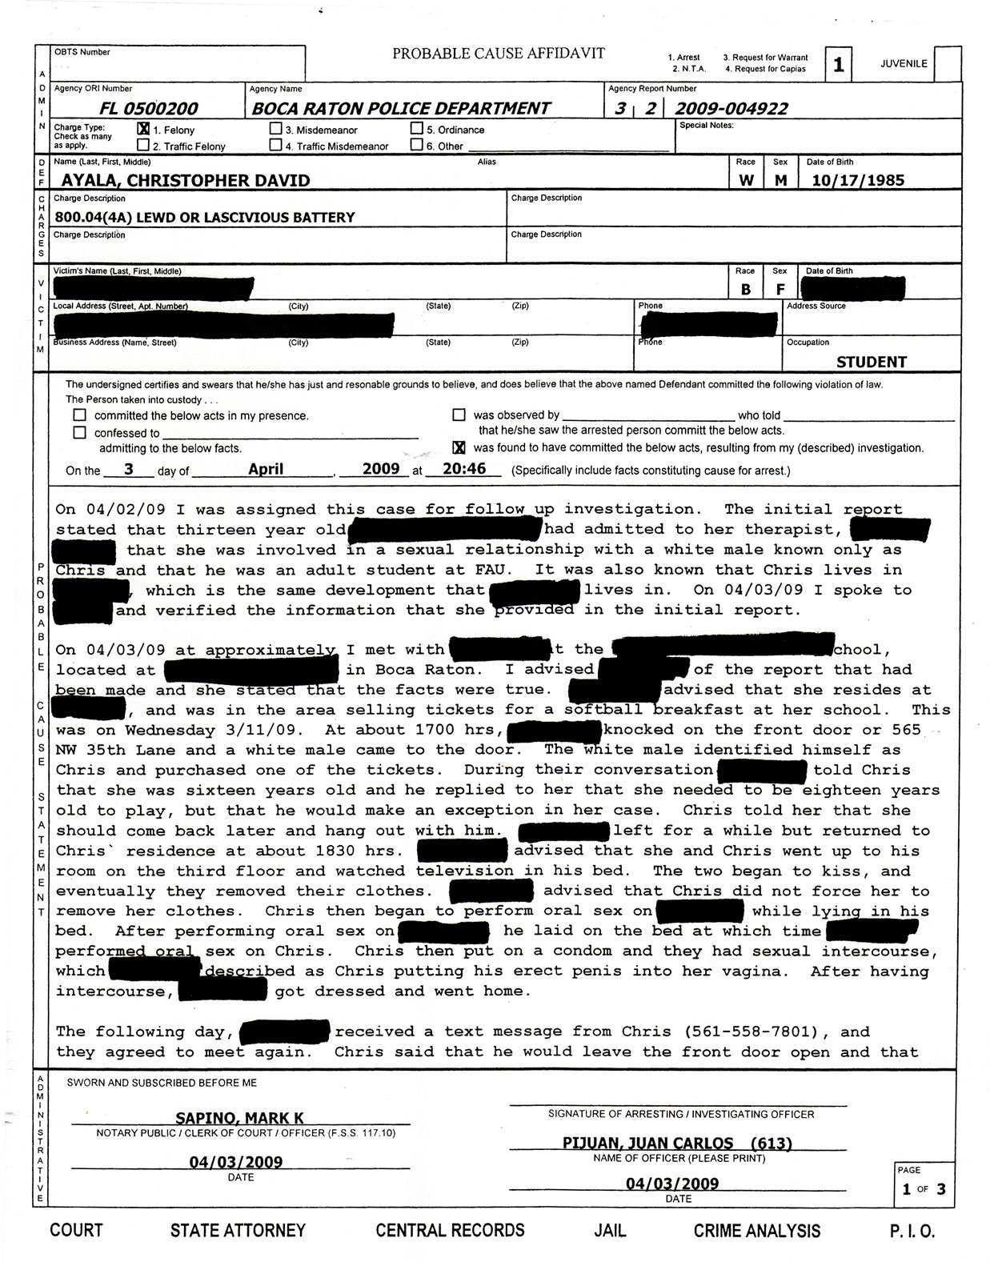
first-person voice
neutral register
language that is used to deliver facts and other non-emotional, unbiased information
“clean” and politically correct diction

Slide 13
What is a manifesto?
manifesto (n):
a written declaration of an organization’s policies and aims

Slide 14
informative title
active and assertive verbs
righteous and confident tone
declarative statements
neatly parceled sections

Slide 15
appeal to pathos
organization’s signature and contact information
visual image / visual depiction of written text

Slide 16
Creative Written Task
Pick a poem:
“Traveling Through the Dark”
“My Papa’s Waltz”
“Blackberry-Picking”
“Ballad of the Landlord”
“And Still I Rise”
Pick a text type:
Blog post
Charity Appeal
Incident Report
Manifesto

