Slide 1
Process Journal + Written report
Ms. Lee MYP Personal Project

Slide 2
Here’s the truth:
The written report is the only piece of work that gets marked.

Slide 3
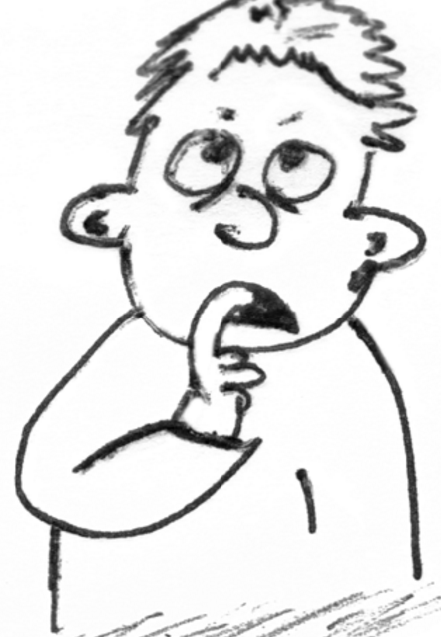
The written report . . .
is marked against four PP assessment criteria:
A: Investigating
B: Planning
C: Taking action
D: Reflecting

Slide 4
The written report . . .
captures and explains in a concise and succinct way the entire process of your personal project, including your:
investigation
planning
action
reflection

Slide 5
The written report is . . .
1500 – 3500 words
written in English
organized into four sections
- A: Investigating
- B: Planning
- C: Taking action
- D: Reflecting
supported by up to 10 extracts

Slide 6
The written report . . .
is not a horrible obstacle at all
if you write in your process journal
in a meaningful way

Slide 7
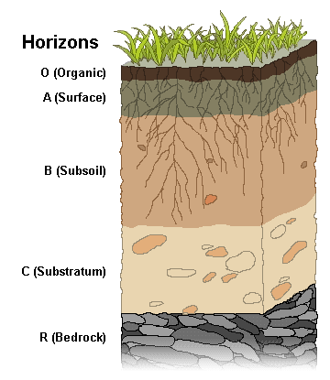
The process journal . . .
is the bedrock of the written report
bedrock: the foundation on which something is based (and also something in Minecraft?)

Slide 8
The process journal . . .
is where you record the progress you make toward achieving your goal

Slide 9
The process journal . . .
is where you record the progress you make toward achieving your goal
is where you capture evidence of your:
- A: Investigating
- B: Planning
- C: Taking action
- D: Reflecting

Slide 10
The process journal . . .
is where you record the progress you make toward achieving your goal
is where you capture evidence of your:
- A: Investigating
- B: Planning
- C: Taking action
- D: Reflecting
http://lmlee.weebly.com/personal-project.html
It’s a really good idea to divide the process journal into these four sections.

Slide 11
The process journal
A: Investigating
B: Planning
C: Taking action
D: Reflecting
It’s a really good idea to divide the process journal into these four sections . . .
. . . with each section focusing on its three specific strands

Slide 12
Criterion A: Investigating
i. define a clear and highly challenging goal and context for the project, based on personal interests
ii. identify prior learning and subject-specific knowledge that is consistently highly relevant to the project
iii. demonstrate excellent research skills

Slide 13
Criterion A: Investigating
i. define a clear and highly challenging goal and context for the project, based on personal interests
ii. identify prior learning and subject-specific knowledge that is consistently highly relevant to the project
iii. demonstrate excellent research skills
ATL
Personal Project gold!!

Slide 14
Criterion B: Planning
i. develop rigorous criteria for the product/outcome
ii. present a detailed and accurate plan and record of the development process of the project
iii. demonstrate excellent self-management skills

Slide 15
Criterion B: Planning
i. develop rigorous criteria for the product/outcome
ii. present a detailed and accurate plan and record of the development process of the project
iii. demonstrate excellent self-management skills
ATL
Personal Project gold!!

Slide 16
Criterion C: Taking action
i. create an excellent product/outcome in response to the goal, global context, and criteria
ii. demonstrate excellent thinking skills
iii. demonstrate excellent communication and social skills

Slide 17
Criterion C: Taking action
i. create an excellent product/outcome in response to the goal, global context, and criteria
ii. demonstrate excellent thinking skills
iii. demonstrate excellent communication and social skills
ATL = Personal Project gold!!

Slide 18
Criterion D: Reflecting
i. present an excellent evaluation of the quality of the product/outcome against the criteria
ii. present excellent reflection on how completing the project has extended knowledge and understanding of the chosen topic and global context
iii. present excellent reflection on development as an IB learner through the project

Slide 19
Criterion A: Investigating
i. define a clear and highly challenging goal and context for the project, based on personal interests
ii. identify prior learning and subject-specific knowledge that is consistently highly relevant to the project
iii. demonstrate excellent research skills
If you write process journal entries

Slide 20
Criterion B: Planning
i. develop rigorous criteria for the product/outcome
ii. present a detailed and accurate plan and record of the development process of the project
iii. demonstrate excellent self-management skills
If you write process journal entries
based on these sections and strands,

Slide 21
Criterion C: Taking action
i. create an excellent product/outcome in response to the goal, global context, and criteria
ii. demonstrate excellent thinking skills
iii. demonstrate excellent communication and social skills
If you write process journal entries
based on these sections and strands,
you can paraphrase the entries and

Slide 22
Criterion D: Reflecting
i. present an excellent evaluation of the quality of the product/outcome against the criteria
ii. present excellent reflection on how completing the project has extended knowledge and understanding of the chosen topic and global context
iii. present excellent reflection on development as an IB learner through the project
If you write process journal entries
based on these sections and strands,
you can paraphrase the entries and
put them in the written report.

Slide 23
If you write process journal entries based on these sections + strands, you can use the entries to compose the written report.
The first section of my written report will respond to Criterion A: Investigating.
I must write something that shows I’ve been able to:
i. define a clear and highly challenging goal and context for the project, based on personal interests . . .
. . . so I’ll just snatch this information from my process journal.

Slide 24
If you write process journal entries based on these sections + strands, you can use the entries to compose the written report.
The first section of my written report will respond to Criterion A: Investigating.
I must write something that shows I’ve been able to:
ii. identify prior learning and subject-specific knowledge that is consistently highly relevant to the project . . .
. . . so I’ll just snatch this information from my process journal.

Slide 25
If you write process journal entries based on these sections + strands, you can use the entries to compose the written report.
The first section of my written report will respond to Criterion A: Investigating.
I must write something that shows I’ve been able to:
iii. demonstrate excellent research skills . . .
. . . so I’ll just snatch this information from my process journal.

Slide 26
Tips
Visit my Weebly for information about:
- PP assessment criteria
- global contexts
- ATL skills
- learner profile traits
I’m going to do my Personal Project while you do yours, so you can use my work as a guide ☺

