Slide 1
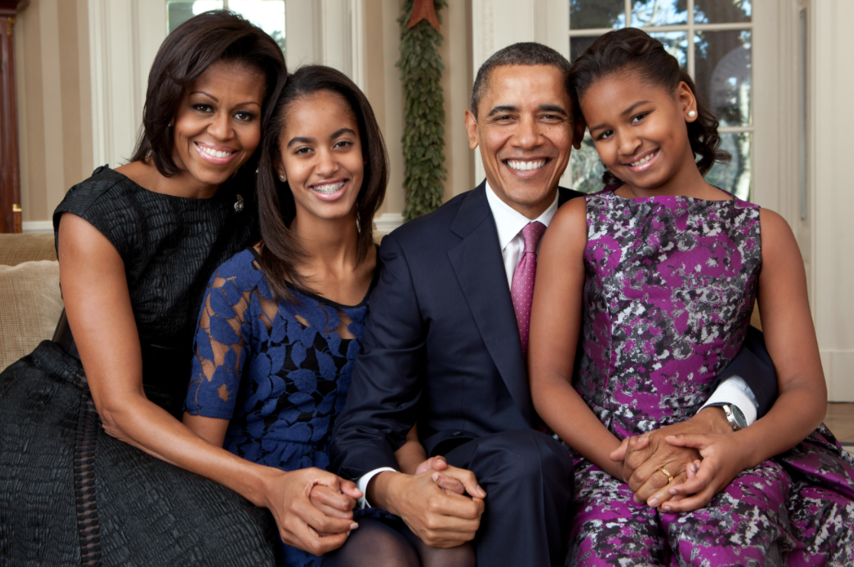
Our Responsibility as Fathers
Barack Obama
June 15, 2008

Slide 2
Purpose of the text:
To arouse a sense of responsibility amongst American fathers
“We need fathers to recognize that responsibility does not just end at conception . . . It’s the courage to raise a child that makes you a father . . .” (37-41).
To promote Obama’s run for the office of the President of the USA
Concerning the “failures of our government” (27), Obama says, “That’s why I’m running for President of the United States of America” (32-33).
Notes:
I’m going to attempt to walk you through the way a strong Language and Literature student would think through this text for a Paper 1 essay.

Slide 3
Purposes:
to arouse a sense of responsibility amongst American fathers
to promote Obama’s run for the office of the President of the USA
Question: What are these purposes based on?
Answer: They are based on the values of the creator of the speech.
value = a person’s judgment of what is important in life

Slide 4
Purposes:
to arouse a sense of responsibility amongst American fathers
to promote Obama’s run for the office of the President of the USA
Values:
What are the values of the creator of this speech?
Obama values a strong family, calling it the rock “upon which we build our lives” (4-5).
Obama values the African-American community, wanting to pull Black families out of “disrepair” (25).
Obama values change in America – change coming from its “government . . . a president . . . each and every one of us” (34-5).

Slide 5
Purposes:
to arouse a sense of responsibility amongst American fathers
to promote Obama’s run for the office of the President of the USA
Question: Why did Obama write this exact speech to achieve his purposes?
Answer: He wrote this exact speech because of the context in which the speech would be delivered.
context = the various circumstances that form the setting for an event, a statement, or an idea.

Slide 6
Context
Speaker’s identity: Barack Obama
an African-American
a family-oriented man with a wife and daughters
a Christian who attends church
a politician running for the office of the President of the United States
Father’s Day
a holiday on which fathers are especially honored and celebrated by their children
Church
a place where Christian people gather to worship God together
a place that fosters strong social bonds

Slide 7
Context
USA
a country with a history of oppression against Blacks
a country where over half of Black children live in single-parent households
a democratic nation in which citizens elect their political leaders
2008
a year in which a presidential election is scheduled
Right now, this is just a list of information about who Obama is, and where he stands at this moment in place and time.
It’s not that meaningful ☹

Slide 8
We must put it together to make inferences about this society:
We can infer that in 2008, the African-American community is in a state of disrepair, and Black children are suffering as a result.
Then, we have to connect it to the purpose of the speech:
Obama believes that he can improve these matters by becoming the next US President. That is why he makes this speech in a Black church on Father’s Day; it is to showcase his success as a Black father and his deep sense of understanding as a Black man – all in order to garner support for his presidential campaign. If elected, he can improve the lives of those who are currently suffering.

Slide 9
We must put it together to make inferences about this society:
We can infer that in 2008, the African-American community is in a state of disrepair, and Black children are suffering as a result.
This sets you up for Paragraph 1: text type + context
Then, we have to connect it to the purpose of the speech:
Obama believes that he can improve these matters by becoming the next US President. That is why he makes this speech in a Black church on Father’s Day; it is to showcase his success as a Black father and his deep sense of understanding as a Black man – all in order to garner support for his presidential campaign. If elected, he can improve the lives of those who are currently suffering.
This sets you up for Paragraph 2: purpose + audience

