Slide 1
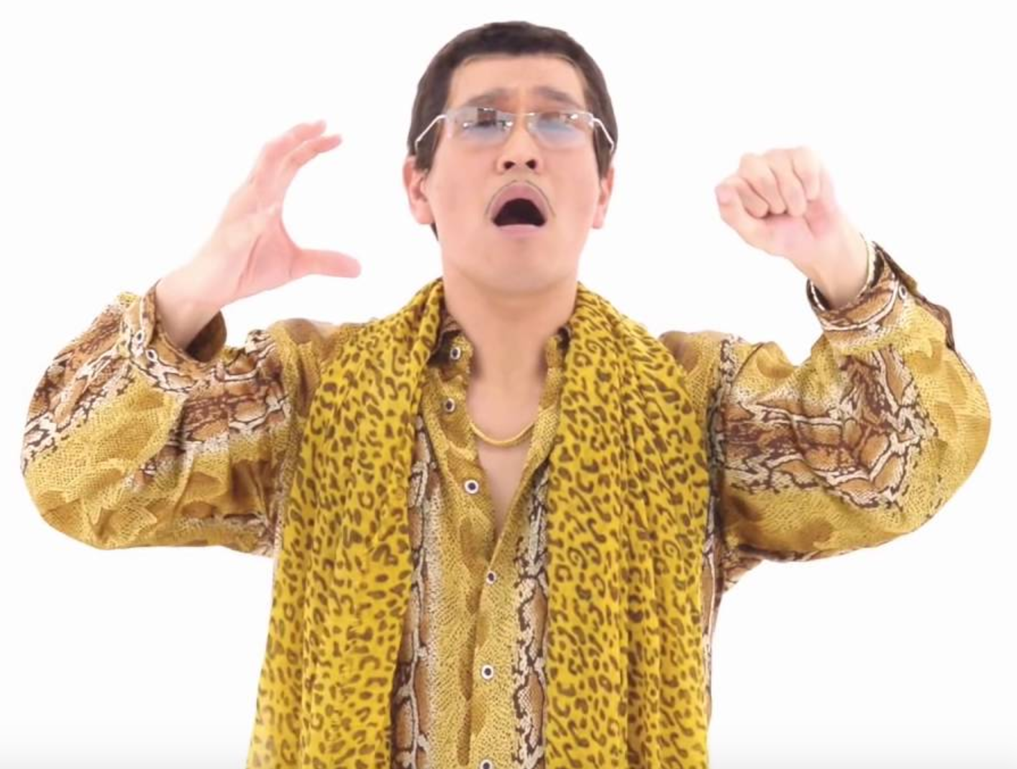
Memes

Slide 2
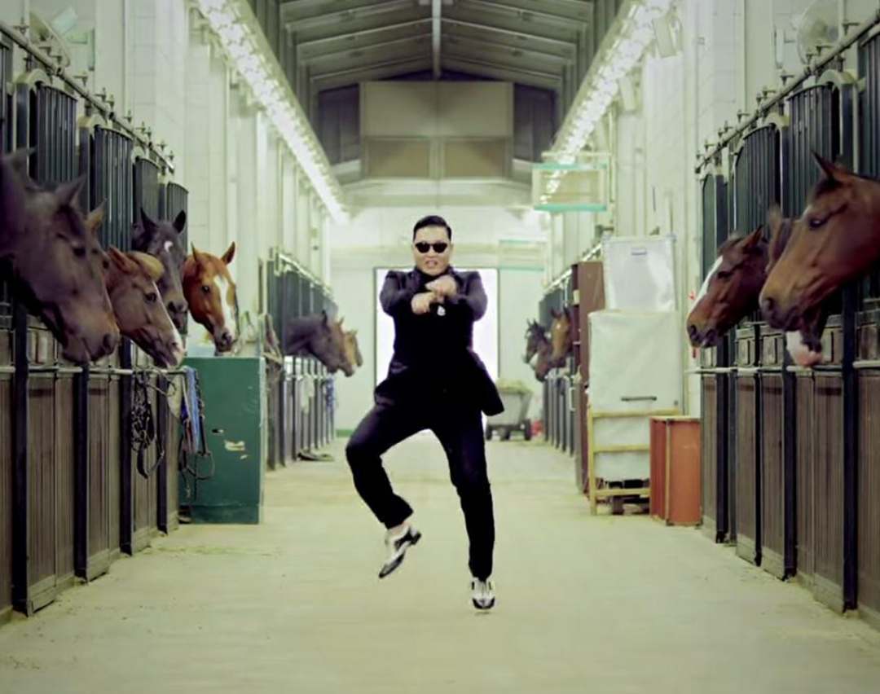
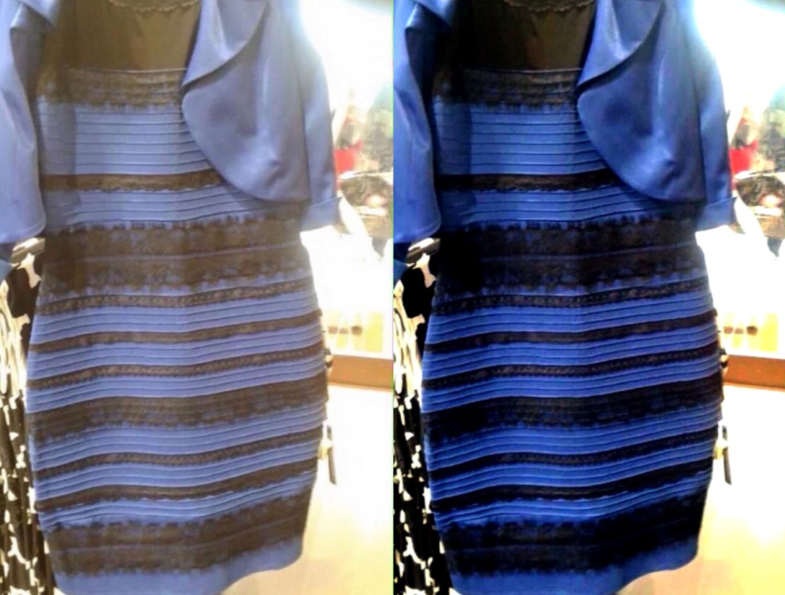
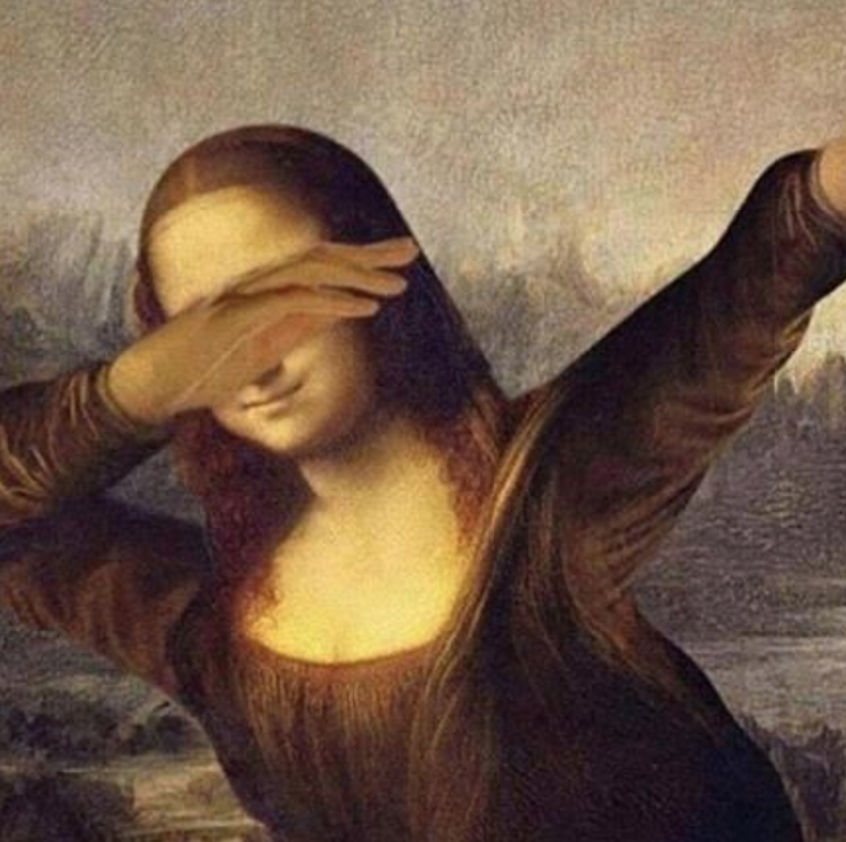
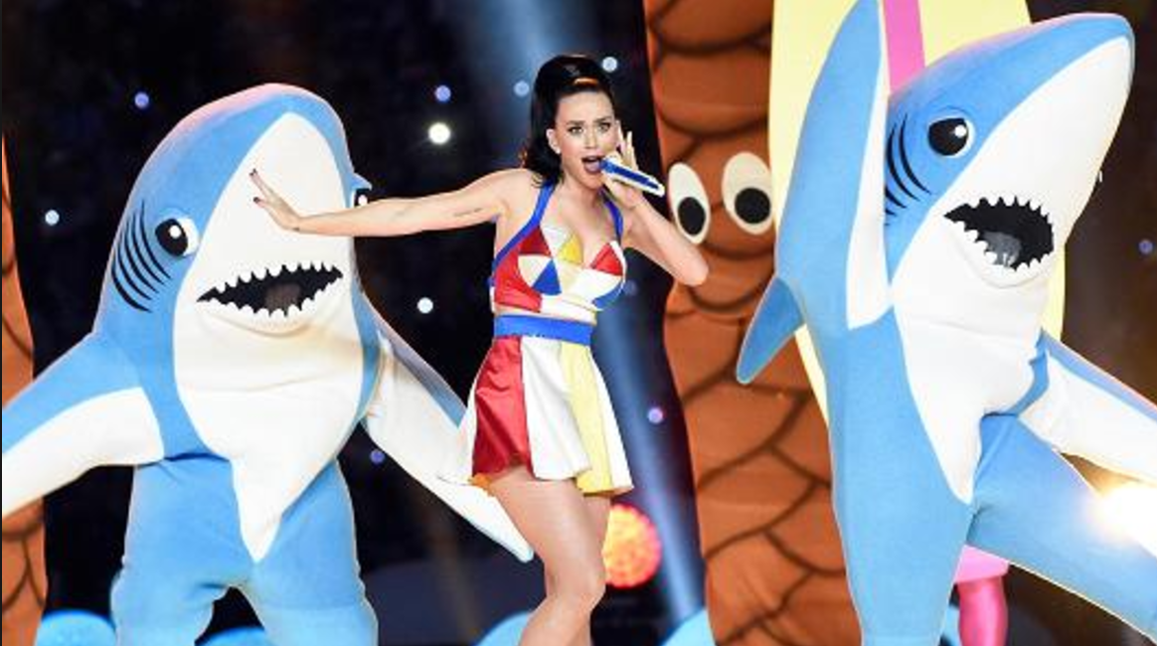
What is a meme?

Slide 3
What is a meme?
In 1976, the evolutionary biologist, Richard Dawkins, wondered:
What if ideas were like organisms, where they could breed + mutate?

Slide 4
What if ideas were like organisms, where they could breed + mutate?
Ideas are born in the brain and spread outward to other people.
Ideas compete against other ideas, battling for attention and survival.
Strong ideas succeed and get passed on; weak ideas die out.

Slide 5
What if ideas were like organisms, where they could breed + mutate?
Dawkins originally called this concept mimeme, from the Greek word meaning “that which is replicated”.
He shortened it to meme, drawing likeness with gene, which undergoes replication, mutation, competition, and inheritance.

Slide 6
What is a meme?
It is an idea, behavior, or style that is easy to copy and spreads from person to person within a culture – a viral phenomenon.

Slide 7
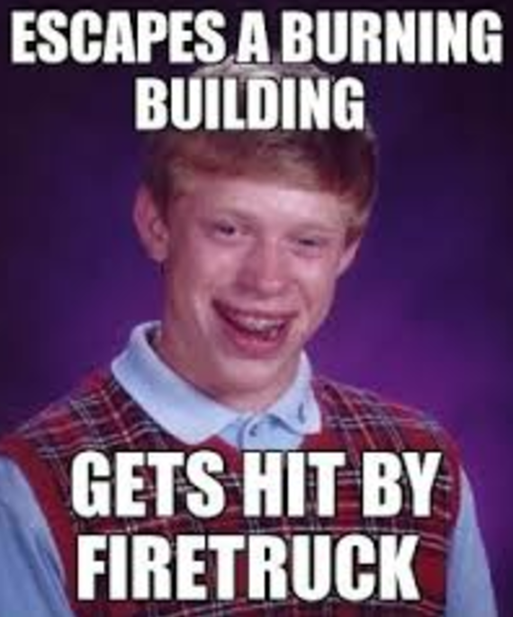
What makes a meme effective?
Notes:
Bad Luck Brian

Slide 8
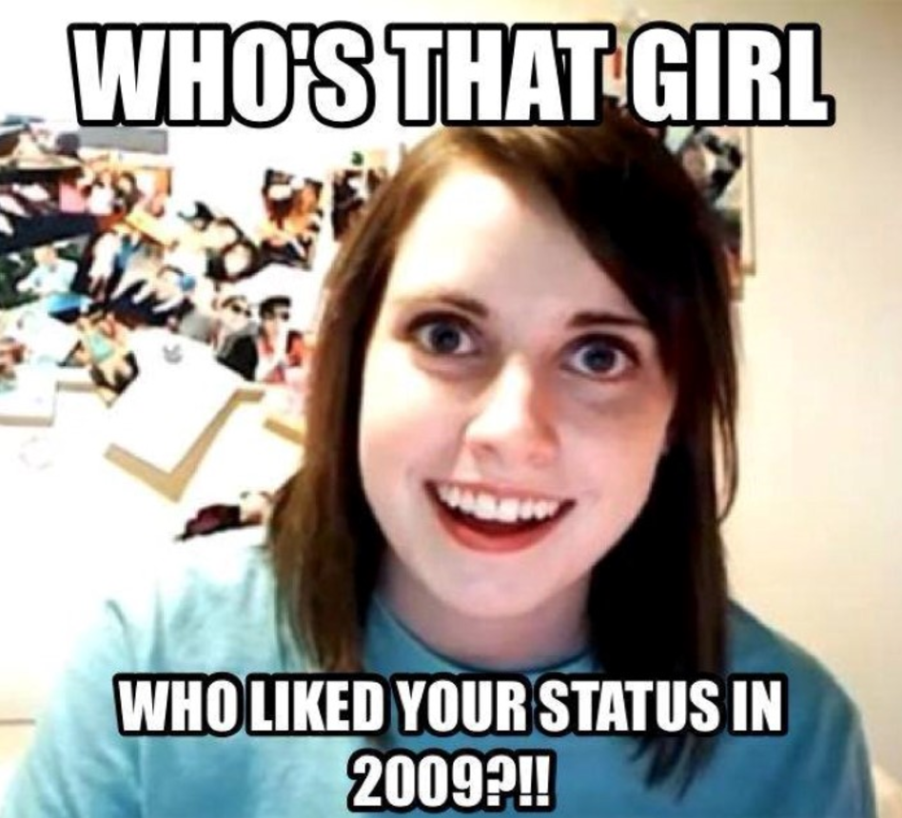
What makes a meme effective?
Notes:
Overly Attached Girlfriend

Slide 9
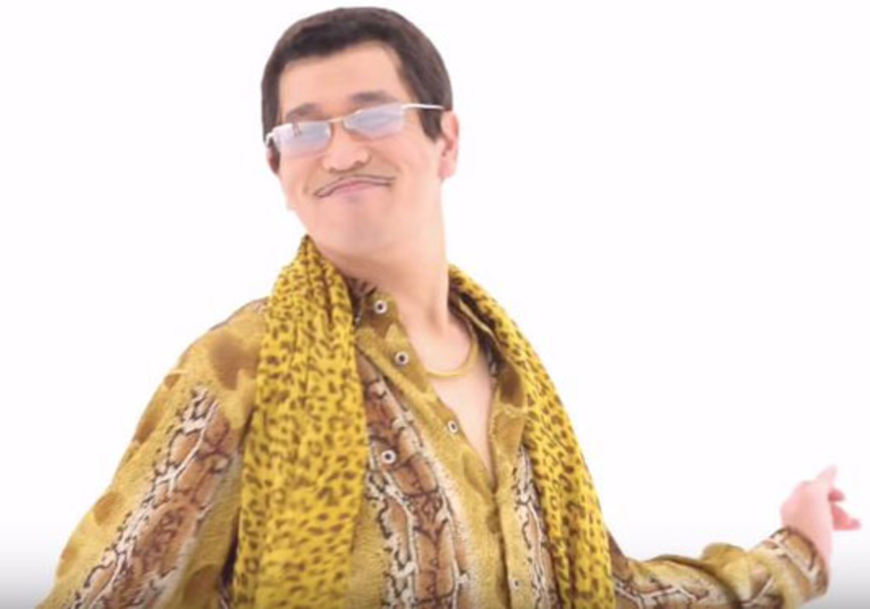
Your homework assignment:
Find a meme that you believe is effective and successful.
Write a one-page analysis that explains how it achieves its effect.
Consider:
Context
Diction
Visual image
Synergy between written and visual texts

Slide 10
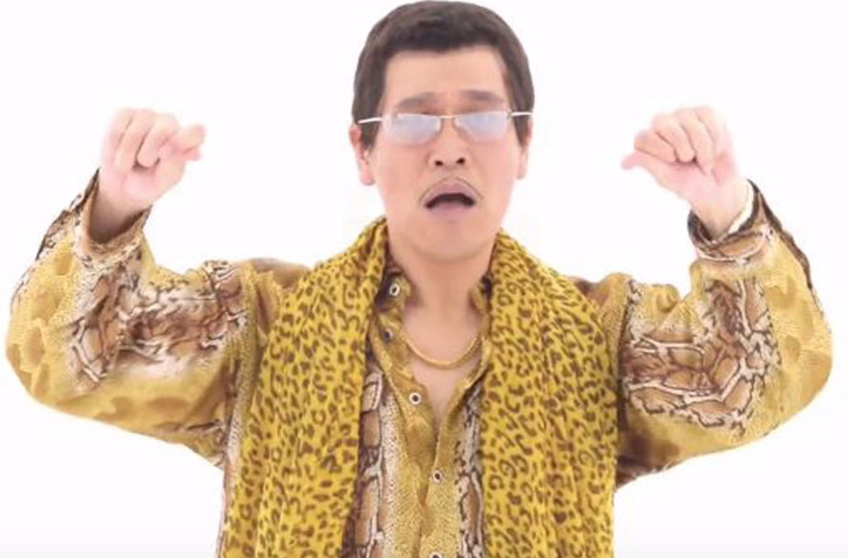
FOA (in a pair or trio)
A presentation exploring –
What makes a meme effective?
Why do people like memes? How do they impact us?
What can memes do that other text types can’t do?

