Slide 1
Infographics

Slide 2
Infographic:
combination of information and graphics
visual and numerical representation of data that presents information quickly and clearly in an eye-catching and digestible way
satisfies our inherent preference for brevity, speed, patterns, and colors
suits our mass communication habits and the increasingly visual world

Slide 3
Conventions of an infographic:
Data visualization
.
Graphs
Charts
Diagrams
Timelines
Maps
Rankings
Content
.
Numbers
Statistics
Percentages
Short phrases (minimized word use)

Slide 4
Conventions of an infographic:
Layout features
.
Multiple colors
Simple pictures (universally recognizable)
Various font types and sizes
Bold / highlighted words and numbers
Cells / compartments
Lines / arrows

Slide 5
Conventions of an infographic:
Usability
.
Visually stimulating
Fast to read
Quotable / shareable
Appeals to logos
Synergy between written text and visual images

Slide 6
Popularity of infographics:
Based on the volume of searches in Google Trends, the popularity of infographics increased 800% from 2010 to 2012.
We want to find information quickly and without much effort.
We don’t want to read and sort through information on their own.
We suffer from information overload.
Why?

Slide 7
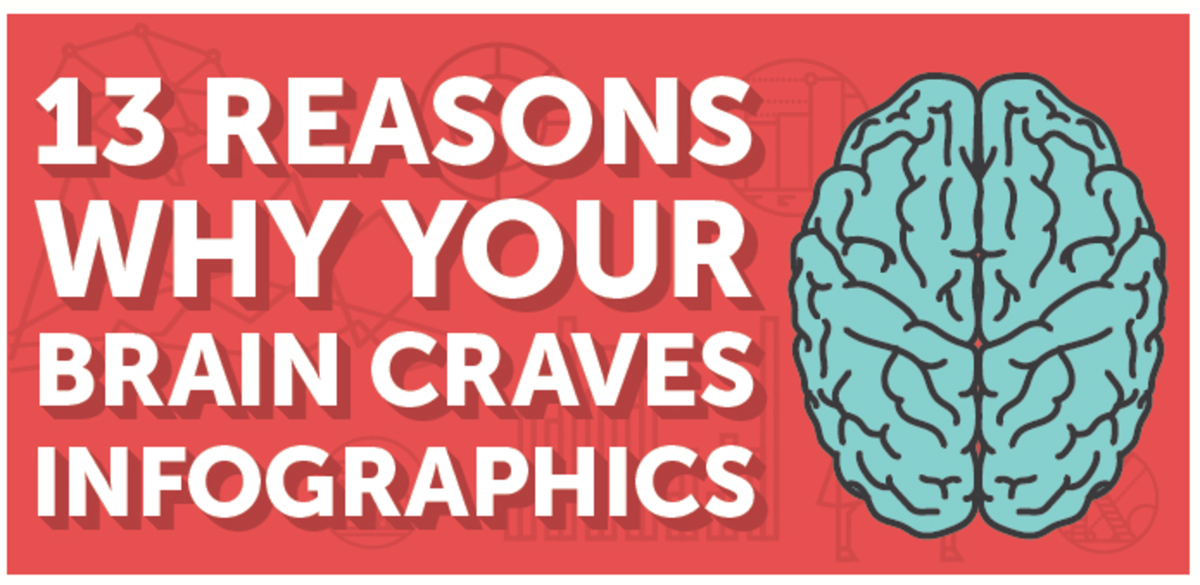

Slide 8
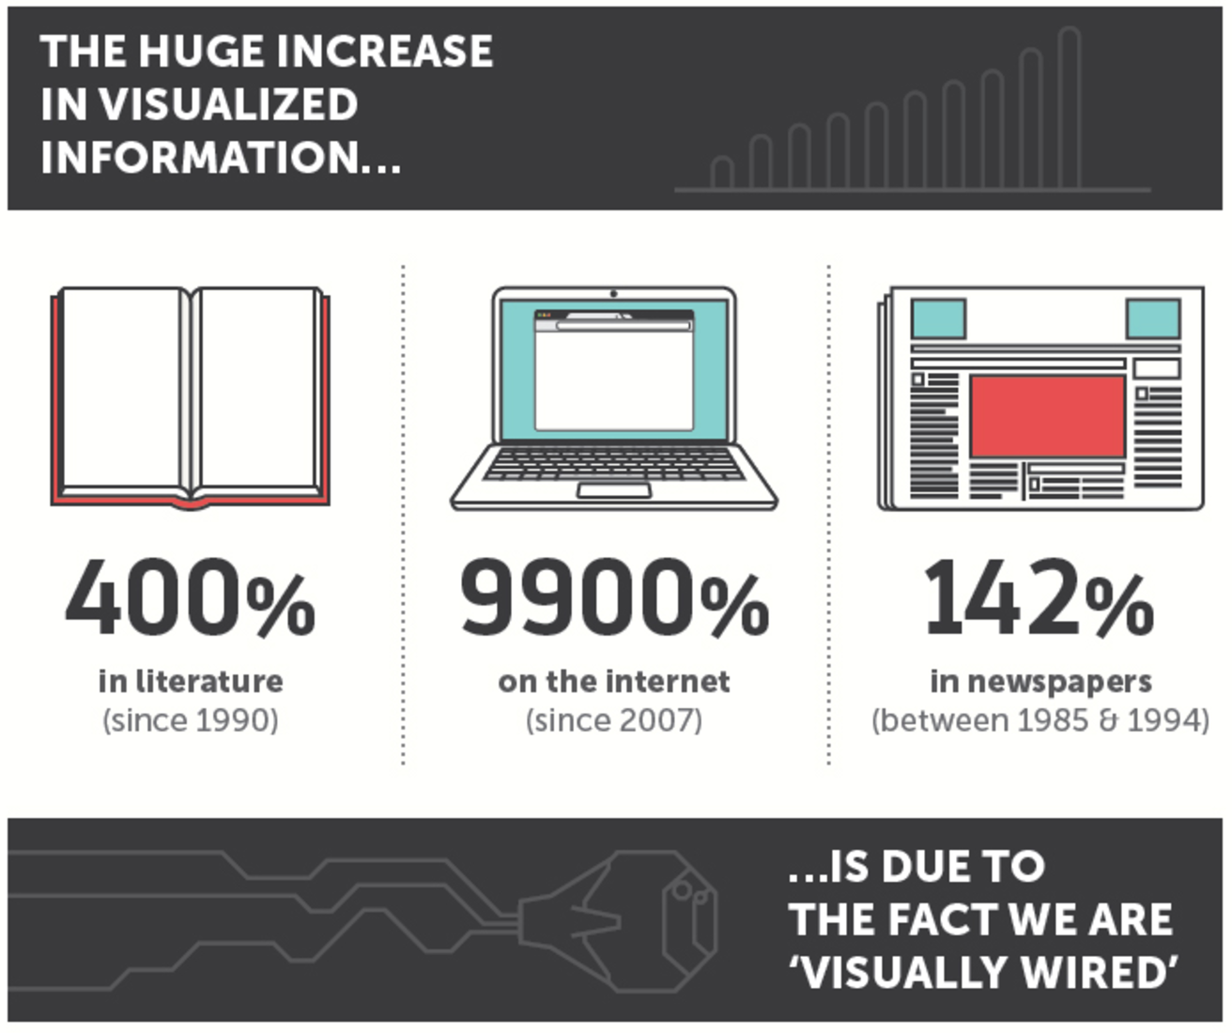

Slide 9
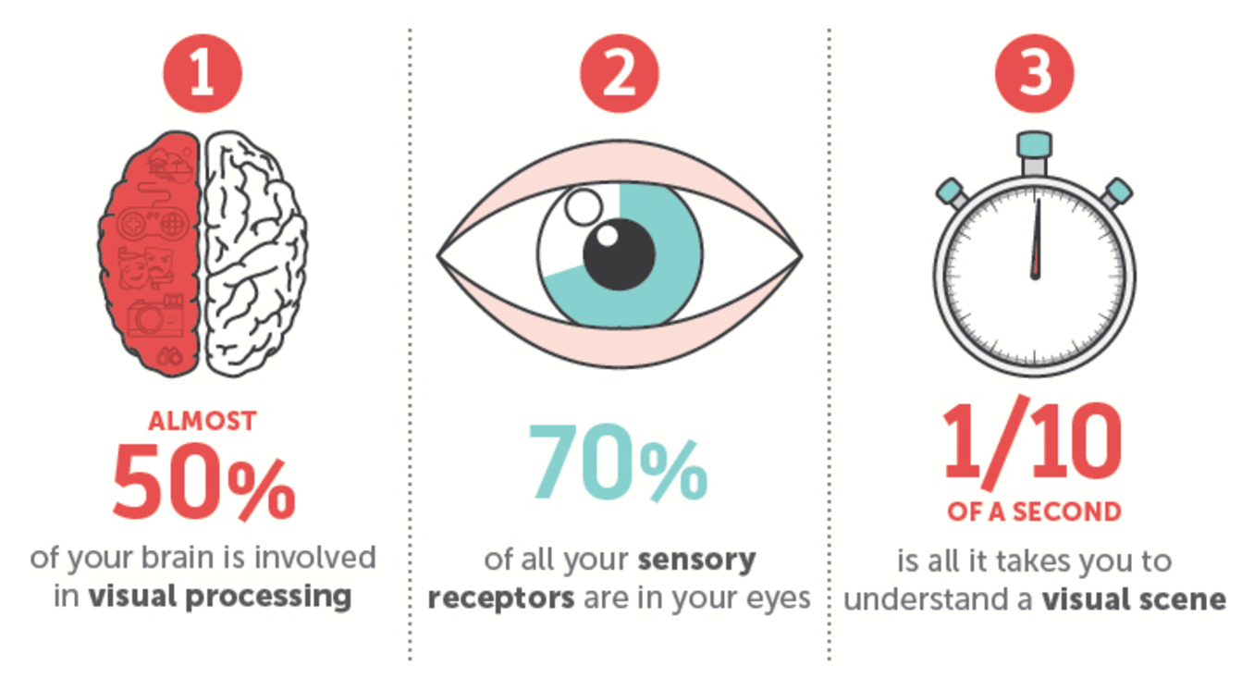

Slide 11
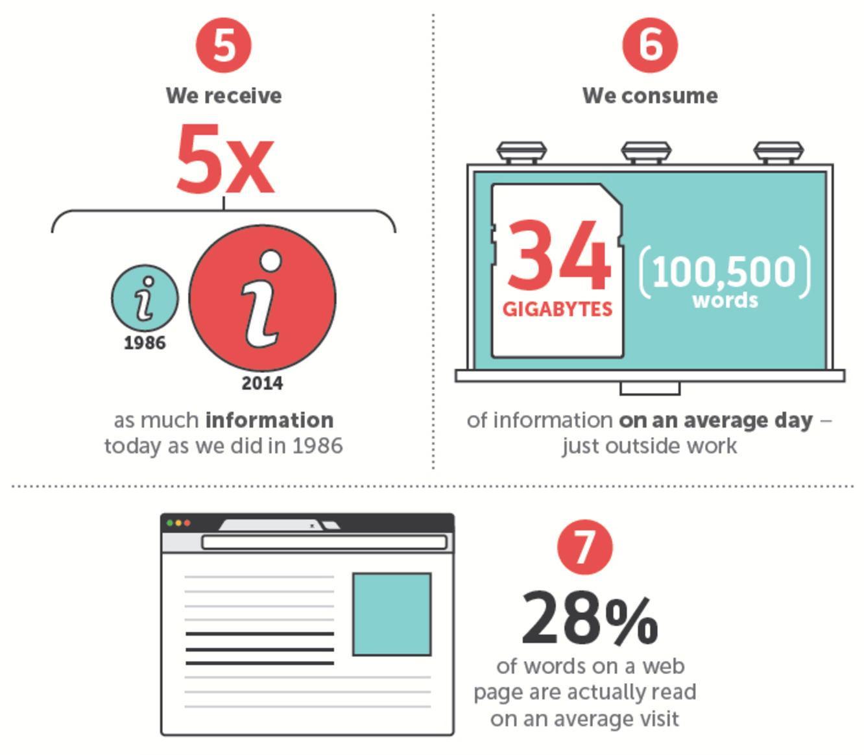

Slide 12
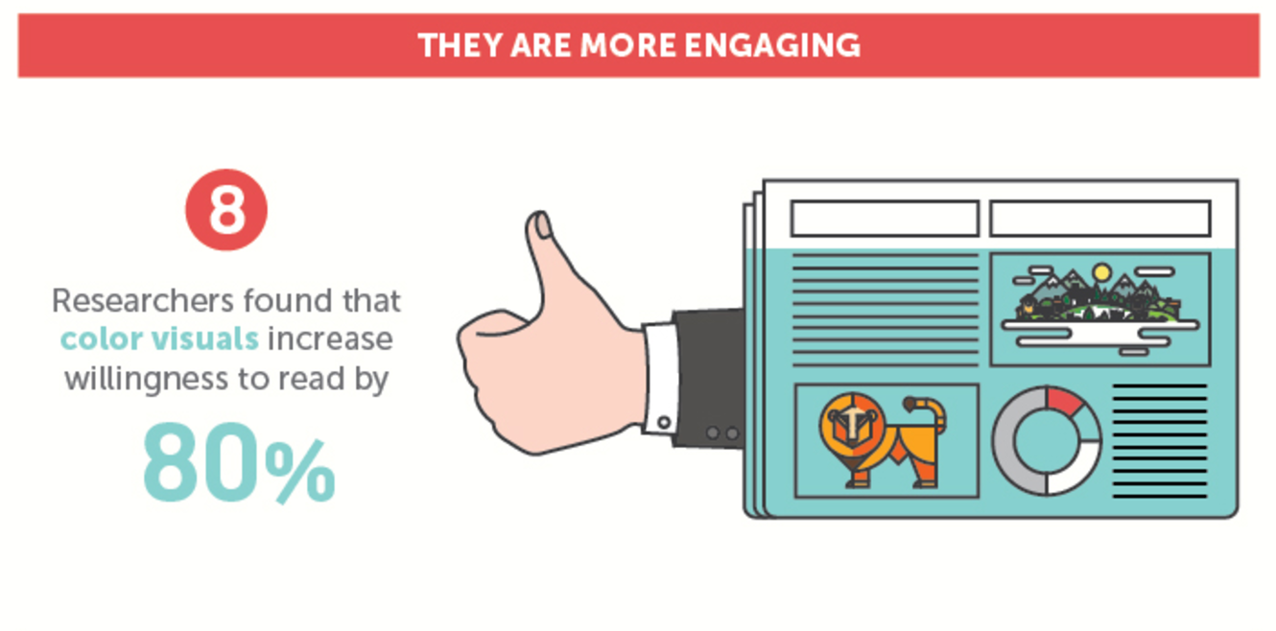

Slide 13
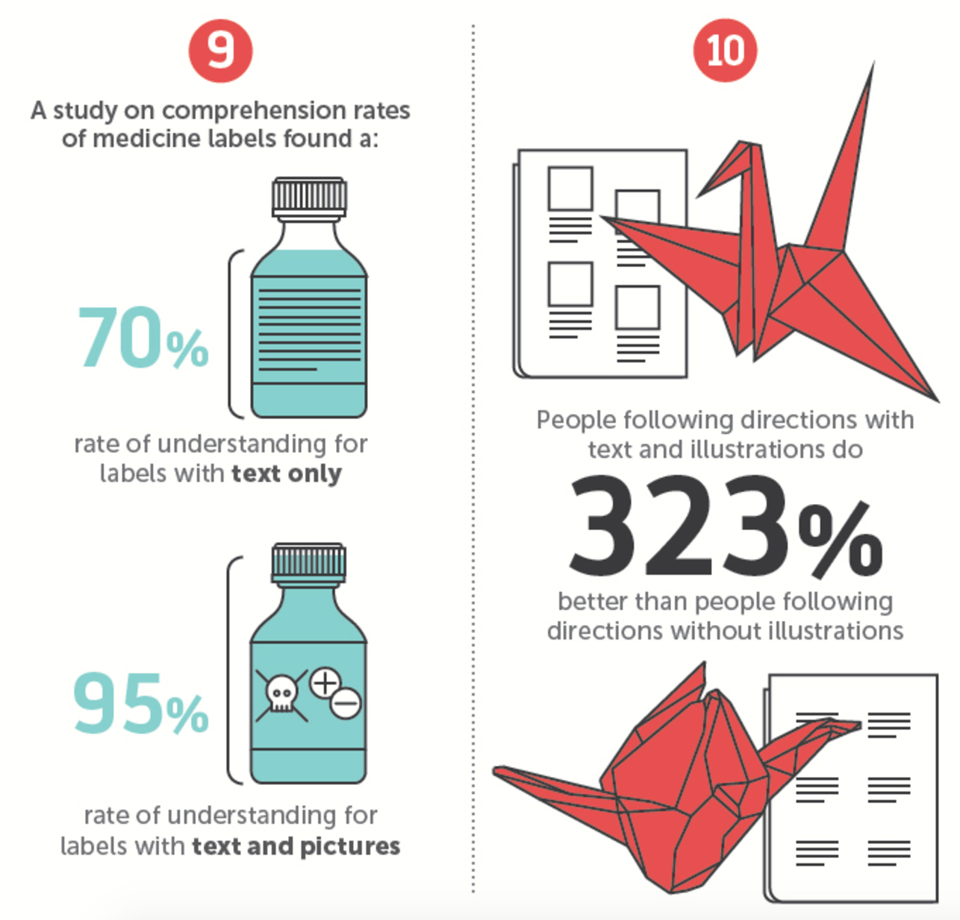

Slide 14
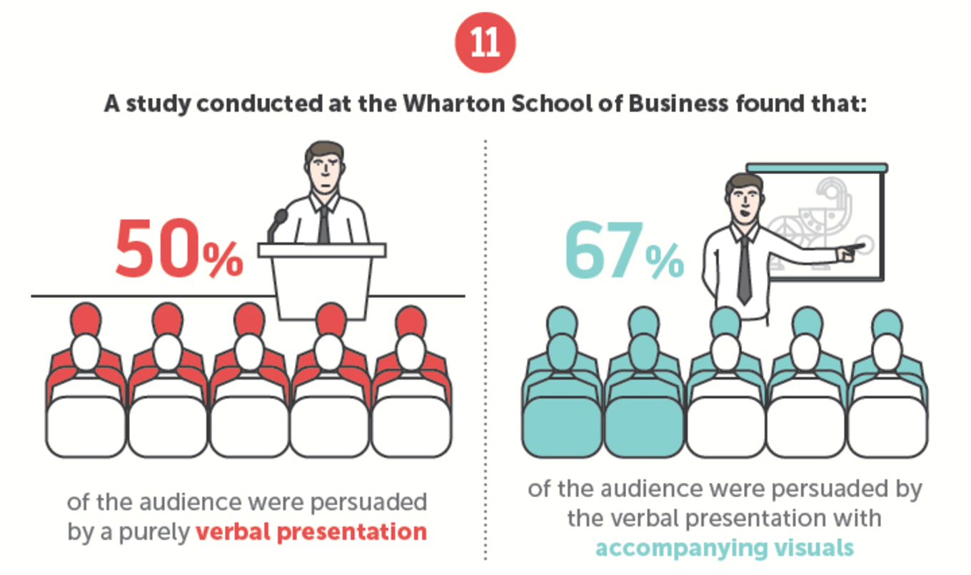

Slide 16
