Slide 1
The Great Gatsby
Summative Assessment Preparation

Slide 2
Summative Assessment: Thesis-driven Essay
Five questions concerning Fitzgerald’s big ideas (the novel’s themes) – you select one
Five class periods for planning and writing
Paper dictionaries and novels allowed – no extra papers or large chunks of written text
October 30th to November 3rd

Slide 3
Summative Assessment: Thesis-driven Essay
Sample Questions
To what extent is Nick Carraway a fundmentally decent character in The Great Gatsby?
How is the pervasiveness of lies and deceit revealed in The Great Gatsby?
Consider the relationship between Gatsby’s character and the American Dream, and explain its connection to one of the themes of The Great Gatsby.

Slide 4
How does Fitzgerald communicate his big ideas?
Through the use of literary devices
These are the building blocks that form a whole story.
Characterization
setting
foil
symbolism
narrator
resolution

Slide 5
How does Fitzgerald communicate his big ideas?
Through the use of literary devices
Setting = the time, place, and type of environment in which an event happens
Narrator = the character who recounts the events of the novel
Characterization = a character’s unique personality as established by her or his words, actions, thoughts, feelings, possessions, and relationship with others

Slide 6
How does Fitzgerald communicate his big ideas?
Through the use of literary devices
Foil = someone who contrasts with a character in order to highlight particular qualities about that character
Symbolism = the use of an object to represent an idea
Resolution = the final outcome at the end of the story

Slide 7
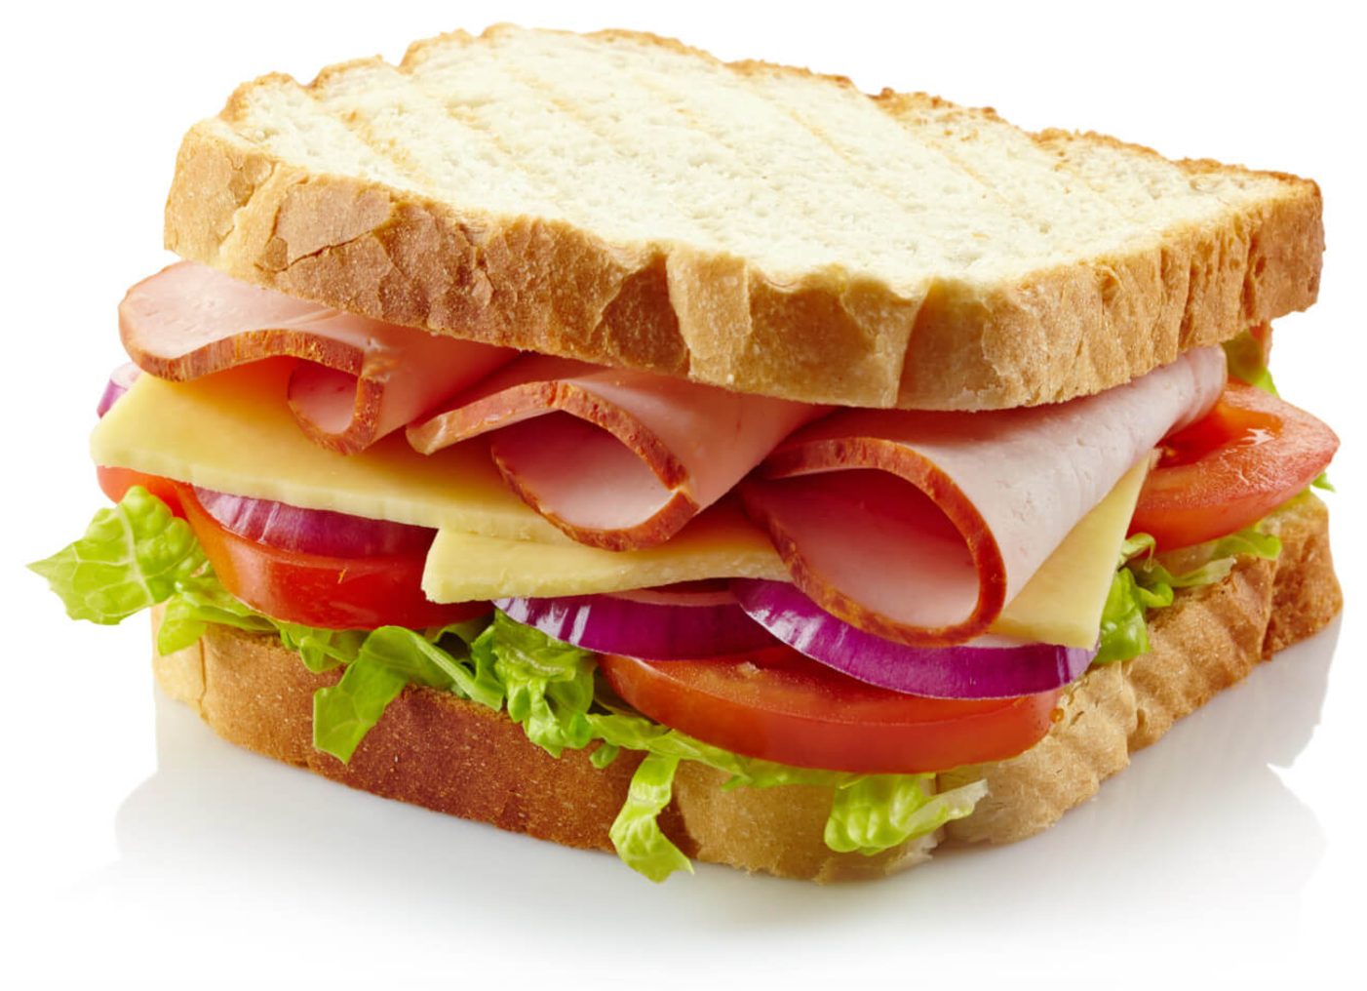
How does Fitzgerald communicate his big ideas?
Through the use of literary devices
These are the various ingredients that make a sandwich.
Characterization
setting
foil
symbolism
narrator
resolution

Slide 8
Visible and Invisible Demands of an Essay Question
Sample Question:
To what extent is Nick Carraway a fundmentally decent character in The Great Gatsby?
(You must also explain how he is or isn’t fundamentally decent.)

Slide 9
Visible and Invisible Demands of an Essay Question
Sample Question:
How is the pervasiveness of lies and deceit revealed in The Great Gatsby?
(You must also explain why it is revealed.)

