Slide 1
Hedda Gabler: Ibsen, Purposes, and Themes

Slide 2
Henrik Ibsen
Born in Norway, 1828
Wrote dramas about con-temporary life in the late 19th century
Focused on uncomfortable topics that people in polite society shied away from talking about
Met Emilie Bardach in 1889 (see p. xxiii)

Slide 3
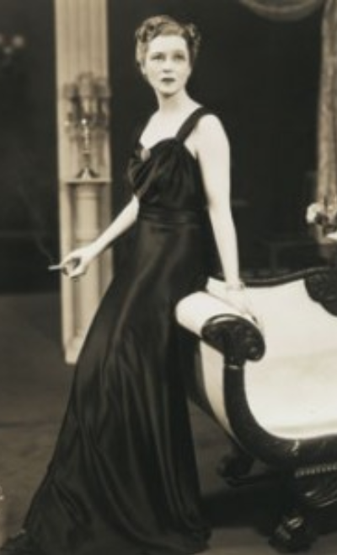
Emilie Bardach
A debutante, 18 years old
Young, bored, and spoiled
Lacked purpose in life, which made her destructive
A predator who enjoyed caus-ing emotional havoc and cap-turing other women’s husbands
Had a flirtatious relationship with Ibsen, 61, for six months
Ibsen cut off correspondence in February 1890 for the sake of self-preservation
Emilie Bardach
=
Hedda Gabler

Slide 4
More context: Aristocracy (p. xxvii)
Norway’s aristocracy formally abolished in 1821
Military families = aristocracy; continued as privileged elite until end of 1800s
Only 11 generals left in Norwegian army by 1890s, when General Gabler retired

Slide 5
More context: Aristocracy (p. xxvii)
Norway’s aristocracy formally abolished in 1821
Military families = aristocracy; continued as privileged elite until end of 1800s
Only 11 generals left in Norwegian army by 1890s, when General Gabler retired
Afterwards, Hedda:
falls from high society into the bourgeois class
marries a bourgeois academic, enters the safe but boring life of middle-class domesticity
suffers from social embarrassment and exclusion

Slide 6
More context: Title of Professor (p. xxviii)
Professors had considera- ble prestige and stable income in 1890s Norway
Tesman’s position can give Hedda financial security and some social standing
Tesman is the solution to Hedda’s problem
Dr. George Tesman

Slide 7
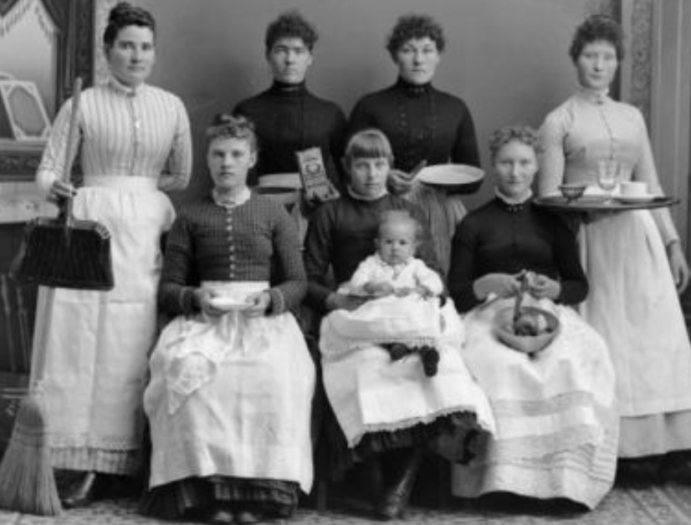
More context: Women in 1890s Norway
From Ibsen’s notes:
“A woman cannot be herself in contemporary society; it is an exclusively male society with laws drafted by men, and with counsel and judges who judge feminine conduct from the male point of view.”

Slide 8
More context: Women in 1890s Norway
Hedda Gabler is a play about:
social conditioning and social expectations interfering with human potential
the dynamics of human relationships, especially what we do to one another

Slide 9
Ibsen’s purpose in writing Hedda Gabler
To expose the flaws of the society in which he and his audience lived (1890s Norway)
To push his audience to recognize the gender norms and social expect-ations that oppressed women

Slide 10
Ibsen’s purpose in writing Hedda Gabler
To give voice to the victims of a patriarchal society (namely women)
To start conversations – both social and internal – that gave his audience the chance to question social norms and imagine a better way to live

Slide 11
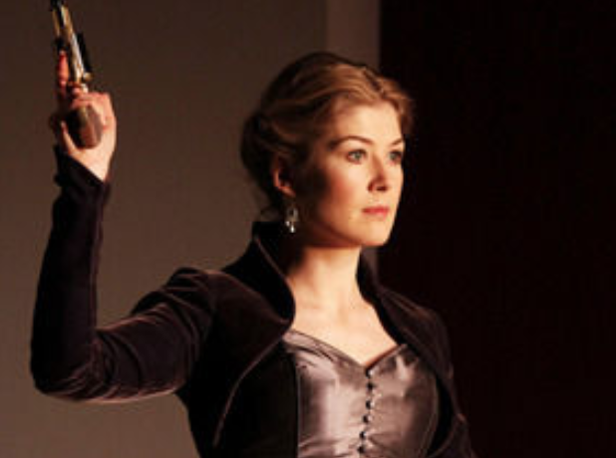
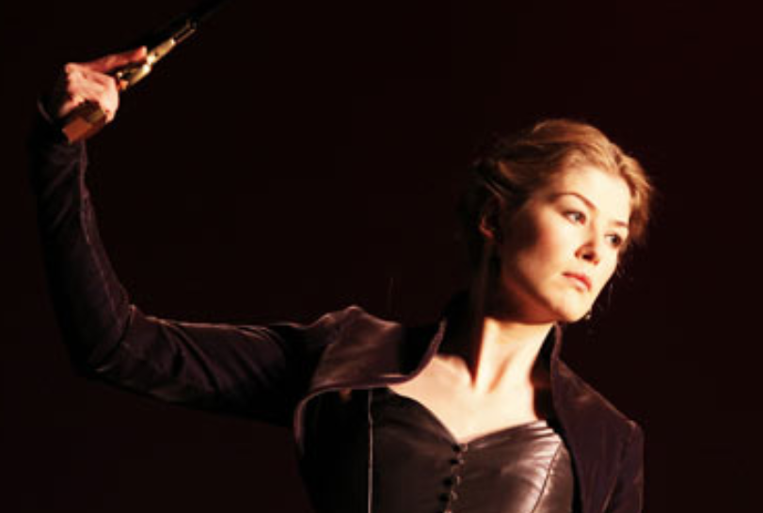
Themes of Hedda Gabler
the quest for self realization
the search for control over one’s self and others
the obstruction of human potential
the oppression of gender norms / a patriarchal society

Slide 12
Ibsen’s Comments on Literature:
“The effect of the play depends a great deal on making the spectator feel as if he were actually sit-ting, listening, and look-ing at events happening in real life.”
Literature as a Mirror
The play functions as a mirror capturing a situation that the reader/viewer is familiar with, thus allowing her to clearly see and examine the social and cultural norms that surround her.

Slide 13
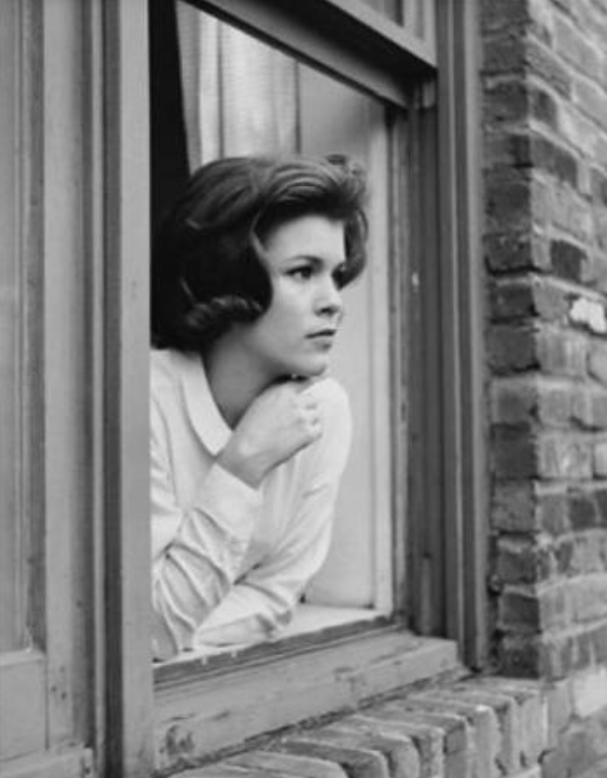
Ibsen’s Comments on Literature:
“The illusion I wished to produce was that of reality.”
Literature as a Window
The play functions as a window that opens into
an unfamiliar world, thus allowing the reader/viewer to experience and learn from a new but equally real situation.

Slide 14
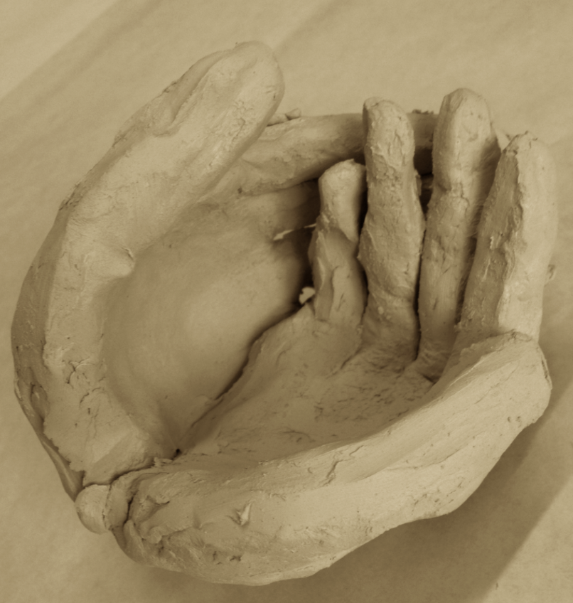
Ibsen’s Comments on Literature:
“My task has been the description of humanity.”
Literature as Exploration of the
Human Condition
The play captures key
events and experiences that compose the essentials of human existence. As such, its content is universal and relevant to all readers/viewers regardless of time or place.

